Slide 1
Unit 2
WHAT I CAN DO
LESSON 1.1 - PAGE 20

Slide 2
Objectives
By the end of this lesson, students will be able to talk about things they can and can't do.
Vocabulary: dance, sing, play the keyboard, paint, draw, act
Structure: I can dance.
I can't draw.

Slide 3
WARM UP

Slide 4
4 things 1 animal

Slide 5
It’s gray.
It’s big.
It has 4 legs.
It has a tail.
e
l
e
p
h
a
n
t

Slide 6
It’s small.
It has 2 legs.
It has feather.
It has 2 wings.
b
i
r
d

Slide 7
It’s tall.
It has 4 legs.
It has a long neck.
It has a tail.
g
i
r
a
f
f
e

Slide 8
It’s time to learn …

Slide 9
New words
dance,
sing,
play the keyboard, paint,
draw,
act

Slide 10
Presentation

Slide 11
Click the icon to hear the sound.

Slide 12
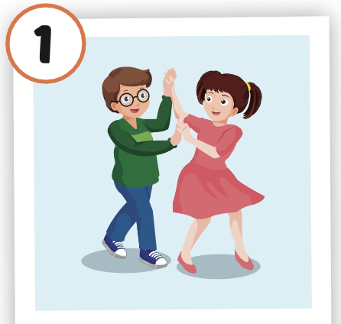
Click the picture to hear the sound.
dance
/ˈdæns/
nhảy múa

Slide 13
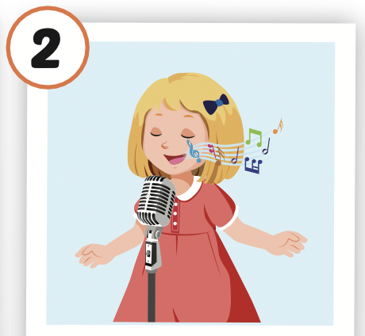
Click the picture to hear the sound.
sing
/sɪŋ/
hát

Slide 14
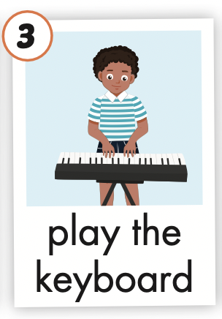
Click the picture to hear the sound.
play the keyboard
/pleɪ ðə ˈkiːbɔːrd/
chơi đàn phím

Slide 15
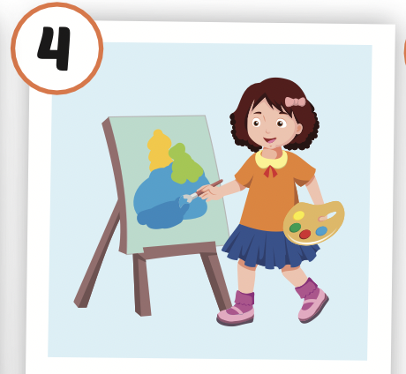
Click the picture to hear the sound.
paint
/peɪnt/
vẽ, sơn

Slide 16
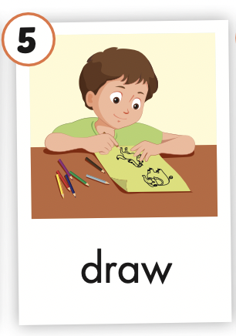
Click the picture to hear the sound.
draw
/drɑː/
vẽ

Slide 17
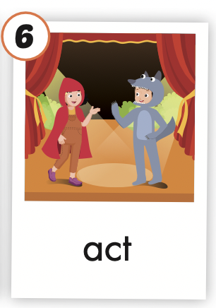
Click the picture to hear the sound.
act
/ækt/
diễn xuất

Slide 18
Practice

Slide 19
LISTEN AND CHOOSE

Slide 24
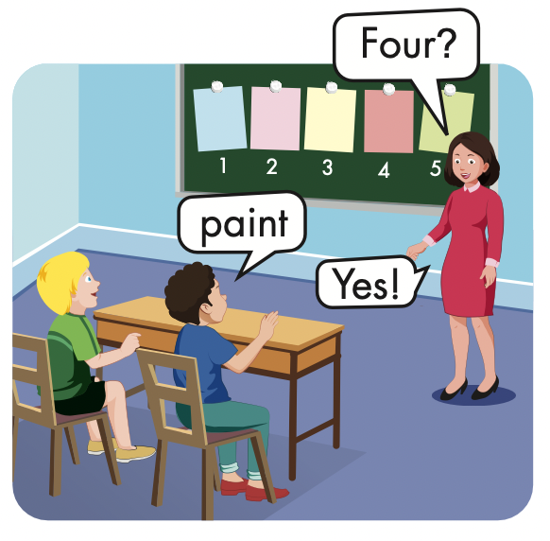
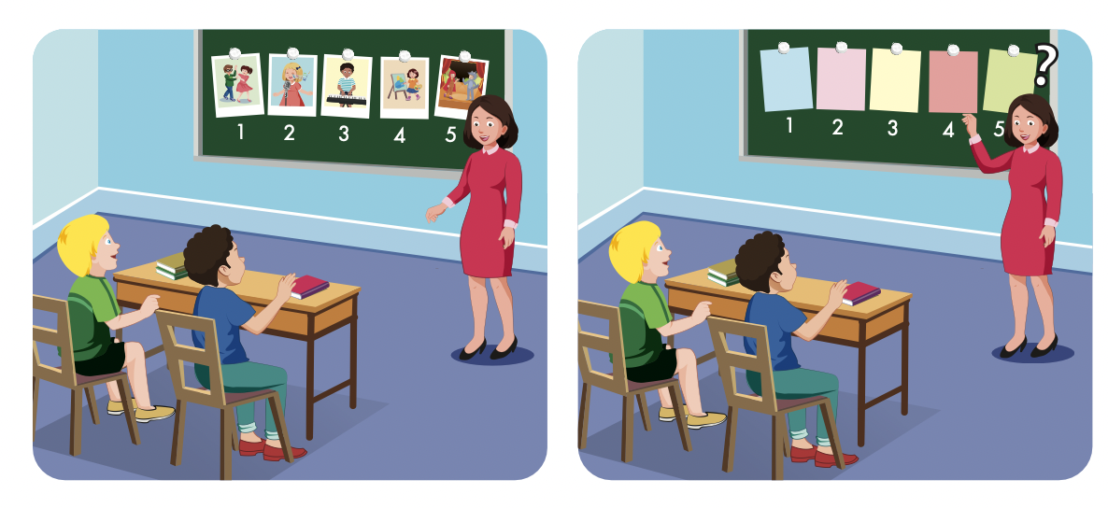

Slide 25
Structures
I can dance.
I can't draw.

Slide 26
Presentation

Slide 27
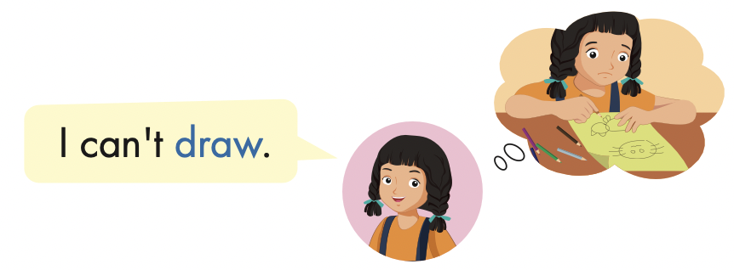

Slide 28
Practice

Slide 29
I can act.

Slide 30
I can’t draw.

Slide 31
I can’t play the keyboard.

Slide 32
I can sing.

Slide 33
Writing

Slide 38
Production

Slide 39
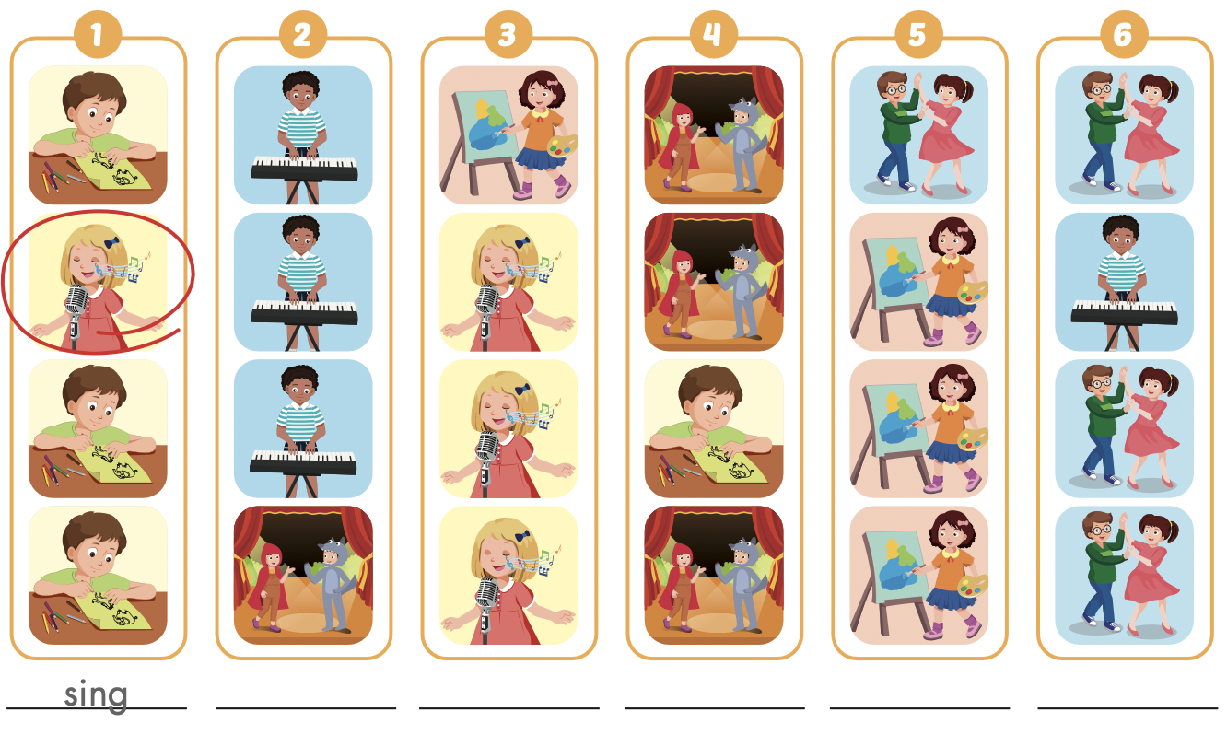
Extra Practice
WB, page 12
act
paint
draw
dance
play the keyboard

Slide 40
CONSOLIDATION

Slide 41
LET’S PLAY!
WHAT’S MISSING?

Slide 48
WRAP-UP

Slide 49
Today’s lesson
Vocabularies
dance,
sing,
play the keyboard, paint,
draw,
act
Structures/ Sentence patterns
I can dance.
I can't draw.

Slide 50
SAY

